Slide 1

STUDENT PERFORMANCE PREDICTION - REGRESSION
PRESENTED BY
Sangu Upasana
Sriram Yogendranath
Venkat Reddy
M. Ashwiz
Erram Harshvardhan

Slide 2
ABOUT THE DATA
BACKGROUND: The objective is to predict the final grades of students based on 30 input variables, each detailing information about students in a Portuguese school.
OBJECTIVE : The goal of the dataset is to forecast the students' final grade (G3) using the provided information about them.
PATH : Team followed a Machine Learning algorithm development process.

Slide 3
Index
Topic | Slide no
Title slide | 1
About the data | 2
Data set | 5
Data cleaning | 6
Exploratory data analysis | 7
Linear regression | 12
Support vector machine (svm) | 13
K-Nearest Neighbors | 14
Decision tree | 15
Random forest | 16
Ada boost | 17
Gradient boost | 18
XG boost | 19
Comparision | 20

Slide 4
summary | 21
Appendix | 22
Thank you | 31

Slide 5
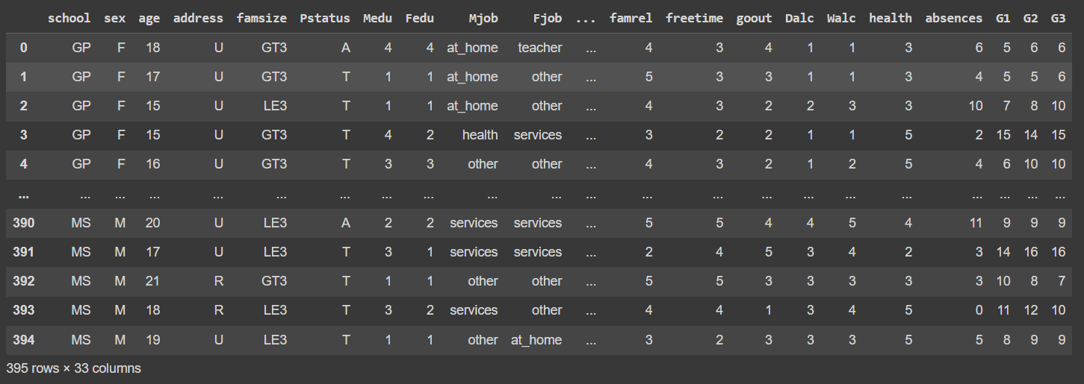
DATA SET:
The data of Student Performance has 33 attributes covering the year 2015.
Ex: -School,sex,age,address,etc. There are 395 instances.

Slide 6
DATA CLEANING :
The data is in the right format, and there are no missing or duplicate values.
In the dataset, there are 17 columns with categories and 16 columns with numbers.
For the columns with only two options, we changed them to 0 and 1 using the map() function.
For the 'reason' column, we created new columns for each category using get_dummies() function.
After that, we added these new columns to the original data and removed the 'reason' column.

Slide 7
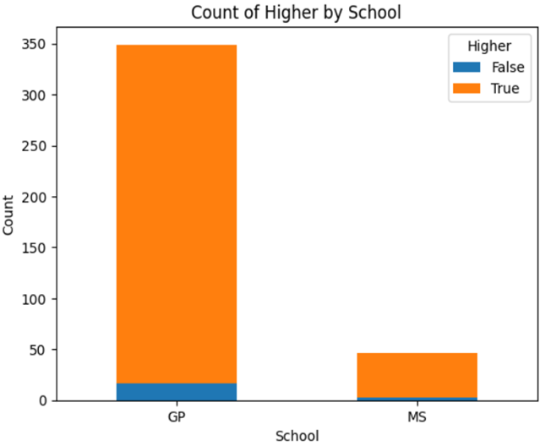
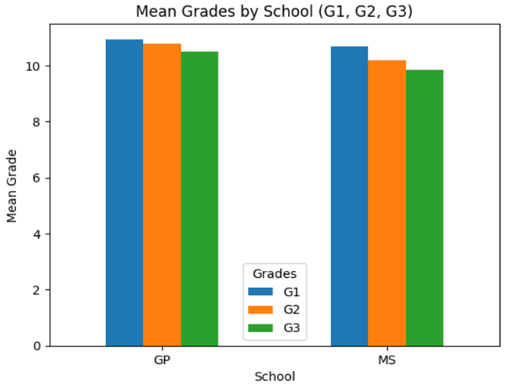
EXPLORATORY DATA ANALYSIS

Slide 8
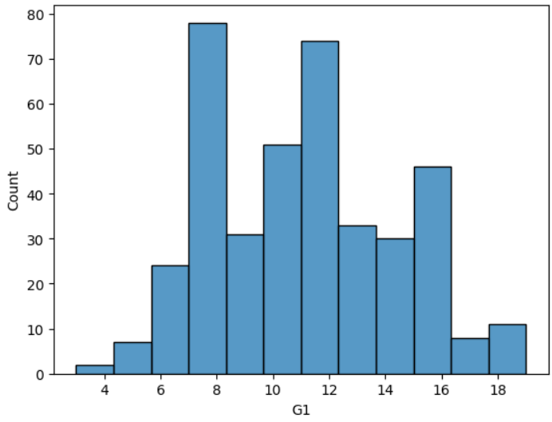
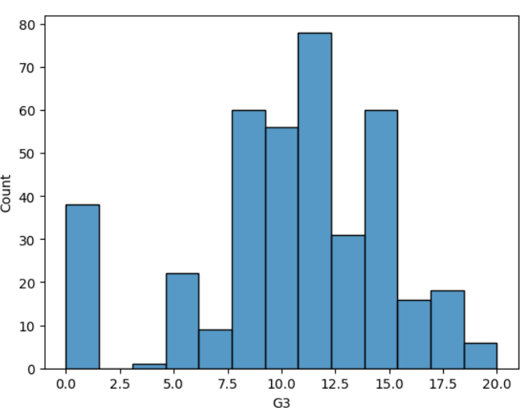
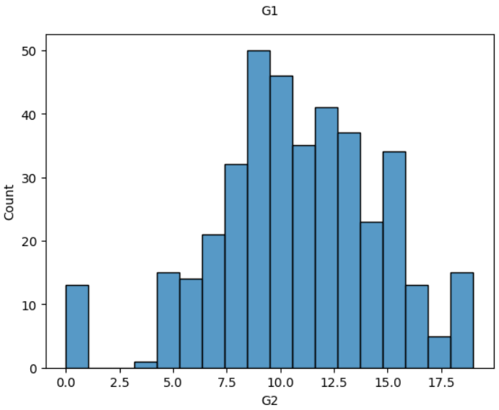
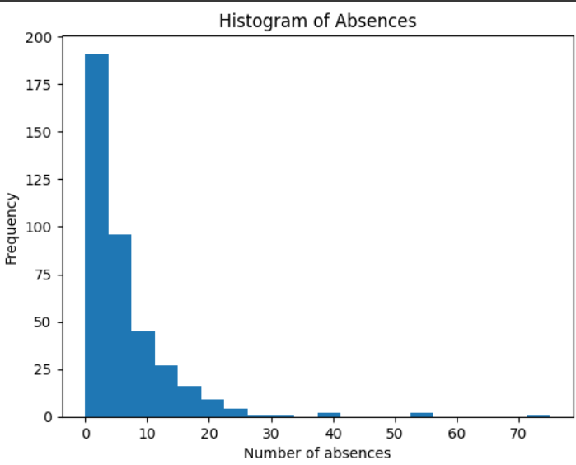

Slide 9
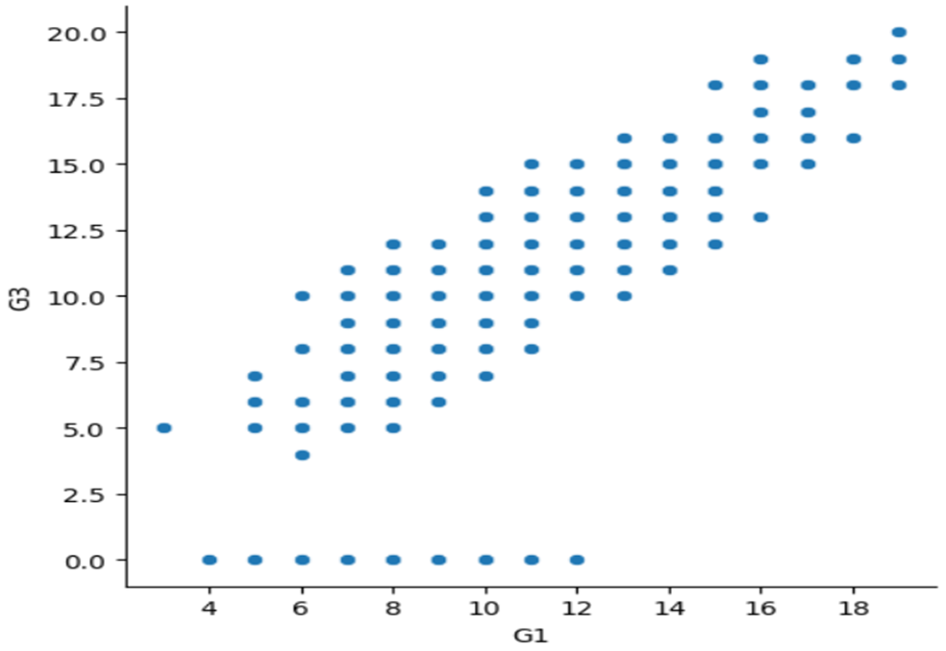
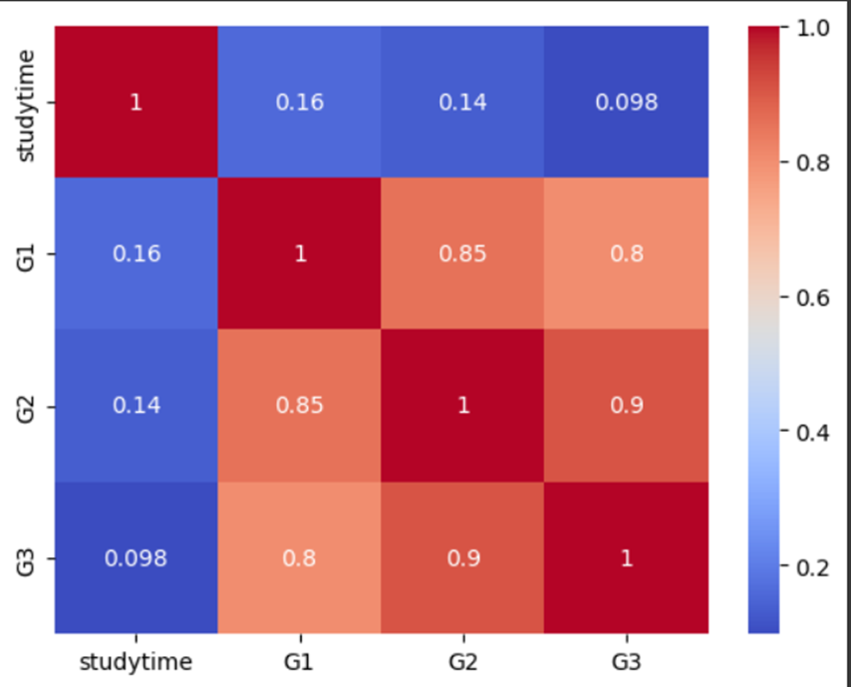
Scatter Plot
Heat Map

Slide 10

By using the above code We drop the columns(‘G1’ ,’G2’) that are highly correlated that can introduce bias in the machine learning algorithm results and lead to inaccurate conclusion

Slide 11
Machine learning algorithms
Linear Regression
Support Vector Machine (SVM)
K-Nearest Neighbors
Decision Tree
Random Forest
Ada Boost
Gradient Boost
XG Boost

Slide 12
Linear Regression
Train test ratio | MSE | R^2
65-35 | 19.6995 | -0.1228
70-30 | 20.1752 | -0.2611
75-25 | 20.4602 | -0.2198
80-20 | 16.0196 | -0.1717

Slide 13
Support Vector Machine (SVM)
Train test ratio | MSE | R^2
65-35 | 20.1974 | 0.1358
70-30 | 18.5691 | 0.1526
75-25 | 19.7313 | 0.1435
80-20 | 18.8403 | 0.0812

Slide 14
K-Nearest Neighbors (KNN)
Train test ratio | MSE | R^2 | N_neighbor
65-35 | 20.884 | 0.1064 | 3
70-30 | 19.8067 | 0.0989 | 3
75-25 | 21.0673 | 0.0855 | 3
80-20 | 19.4599 | 0.0509 | 3
65-35 | 20.1024 | 0.1398 | 5
70-30 | 18.7482 | 0.1471 | 5
75-25 | 18.4464 | 0.1992 | 5
80-20 | 16.7017 | 0.1854 | 5
65-35 | 19.4009 | 0.1698 | 7
70-30 | 18.6544 | 0.1513 | 7
75-25 | 18.2325 | 0.2085 | 7
80-20 | 16.9852 | 0.1716 | 7

Slide 15
Decision Tree
Train test ratio | MSE | R^2 | MAX_depth
65-35 | 21.1841 | 0.0936 | 3
70-30 | 19.0684 | 0.1325 | 3
75-25 | 16.9549 | 0.2640 | 3
80-20 | 19.4701 | 0.0504 | 3
65-35 | 23.2172 | 0.0066 | 5
70-30 | 26.4990 | -0.2054 | 5
75-25 | 15.6853 | 0.3191 | 5
80-20 | 20.0387 | 0.0227 | 5
65-35 | 23.3425 | 0.0012 | 7
70-30 | 28.5923 | -0.3007 | 7
75-25 | 18.0875 | 0.2148 | 7
80-20 | 18.3925 | 0.1030 | 7

Slide 16
Random Forest
Train test ratio | MSE | R^2 | N-Estimators | Max_depth
65-35 | 17.1392 | 0.2666 | 100 | 3
70-30 | 16.9818 | 0.2274 | 100 | 3
75-25 | 16.8523 | 0.2684 | 100 | 3
80-20 | 16.9922 | 0.1713 | 100 | 3
65-35 | 16.6629 | 0.287 | 100 | 5
70-30 | 15.9093 | 0.2762 | 100 | 5
75-25 | 15.5654 | 0.3243 | 100 | 5
80-20 | 16.2085 | 0.2095 | 100 | 5
65-35 | 16.2401 | 0.3051 | 100 | 7
70-30 | 15.6819 | 0.2866 | 100 | 7
75-25 | 15.1396 | 0.3428 | 100 | 7
80-20 | 15.3642 | 0.2507 | 100 | 7

Slide 17
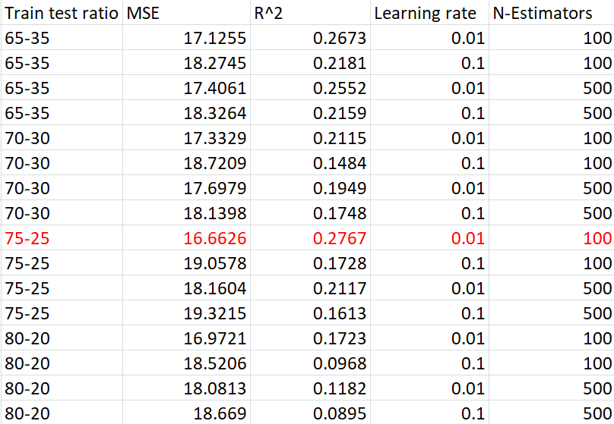
Ada Boost
Train test ratio | MSE | R^2 | Learning rate | N-Estimators
65-35 | 17.1255 | 0.2673 | 0.01 | 100
65-35 | 18.2745 | 0.2181 | 0.1 | 100
65-35 | 17.4061 | 0.2552 | 0.01 | 500
65-35 | 18.3264 | 0.2159 | 0.1 | 500
70-30 | 17.3329 | 0.2115 | 0.01 | 100
70-30 | 18.7209 | 0.1484 | 0.1 | 100
70-30 | 17.6979 | 0.1949 | 0.01 | 500
70-30 | 18.1398 | 0.1748 | 0.1 | 500
75-25 | 16.6626 | 0.2767 | 0.01 | 100
75-25 | 19.0578 | 0.1728 | 0.1 | 100
75-25 | 18.1604 | 0.2117 | 0.01 | 500
75-25 | 19.3215 | 0.1613 | 0.1 | 500
80-20 | 16.9721 | 0.1723 | 0.01 | 100
80-20 | 18.5206 | 0.0968 | 0.1 | 100
80-20 | 18.0813 | 0.1182 | 0.01 | 500
80-20 | 18.6690 | 0.0895 | 0.1 | 500

Slide 18
Gradient Boost
Train test ratio | MSE | R^2 | Learning rate | N-Estimators
65-35 | 19.5601 | 0.1631 | 0.01 | 100
65-35 | 18.8535 | 0.1933 | 0.1 | 500
65-35 | 18.2878 | 0.2175 | 0.01 | 100
65-35 | 21.1037 | 0.097 | 0.1 | 500
70-30 | 18.0662 | 0.1781 | 0.01 | 100
70-30 | 16.1430 | 0.2656 | 0.1 | 500
70-30 | 16.3478 | 0.2563 | 0.01 | 100
70-30 | 19.2084 | 0.1262 | 0.1 | 500
75-25 | 18.4223 | 0.2003 | 0.01 | 100
75-25 | 15.3260 | 0.3347 | 0.1 | 500
75-25 | 16.0959 | 0.3013 | 0.01 | 100
75-25 | 16.3453 | 0.2905 | 0.1 | 500
80-20 | 17.9457 | 0.1248 | 0.01 | 100
80-20 | 15.1497 | 0.2612 | 0.1 | 500
80-20 | 15.6788 | 0.2354 | 0.01 | 100
80-20 | 15.4784 | 0.2451 | 0.1 | 500

Slide 19
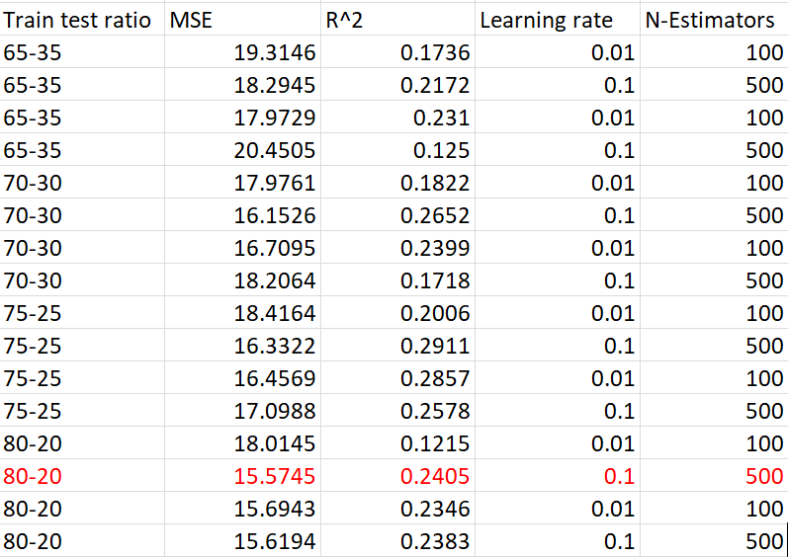
XG Boost
Train test ratio | MSE | R^2 | Learning rate | N-Estimators
65-35 | 19.3146 | 0.1736 | 0.01 | 100
65-35 | 18.2945 | 0.2172 | 0.1 | 500
65-35 | 17.9729 | 0.231 | 0.01 | 100
65-35 | 20.4505 | 0.125 | 0.1 | 500
70-30 | 17.9761 | 0.1822 | 0.01 | 100
70-30 | 16.1526 | 0.2652 | 0.1 | 500
70-30 | 16.7095 | 0.2399 | 0.01 | 100
70-30 | 18.2064 | 0.1718 | 0.1 | 500
75-25 | 18.4164 | 0.2006 | 0.01 | 100
75-25 | 16.3322 | 0.2911 | 0.1 | 500
75-25 | 16.4569 | 0.2857 | 0.01 | 100
75-25 | 17.0988 | 0.2578 | 0.1 | 500
80-20 | 18.0145 | 0.1215 | 0.01 | 100
80-20 | 15.5745 | 0.2405 | 0.1 | 500
80-20 | 15.6943 | 0.2346 | 0.01 | 100
80-20 | 15.6194 | 0.2383 | 0.1 | 500

Slide 20
Comparision
Linear regression | 16.0196
Support vector machine | 18.5691
K-Nearest neighbor | 16.7017
Decision tree | 16.9549
Random forest | 15.1396
Ada boost | 16.6626
Gradient boost | 15.1497
XG boost | 15.5745

Slide 21
Summary
For the given data we performed eight types of machine learning algorithms : linear regression , support vector machine (svm),
K-nearest neighbor , random forest , decision tree , ada boost , gradient boost and XG boost .
From all the implementation Of the algorithms we found that random forest is the best algorithm with the parameters of max_depth=7 and n_estiamtor=100 for the 75-25 test ratio with mean square error (MSE) of 15.1396 which is least compared to all other algorithms
Conclusion : We can conclude that random forest is the best algorithm to be considered for the given data student grade
prediction

Slide 22
Appendix

Slide 23
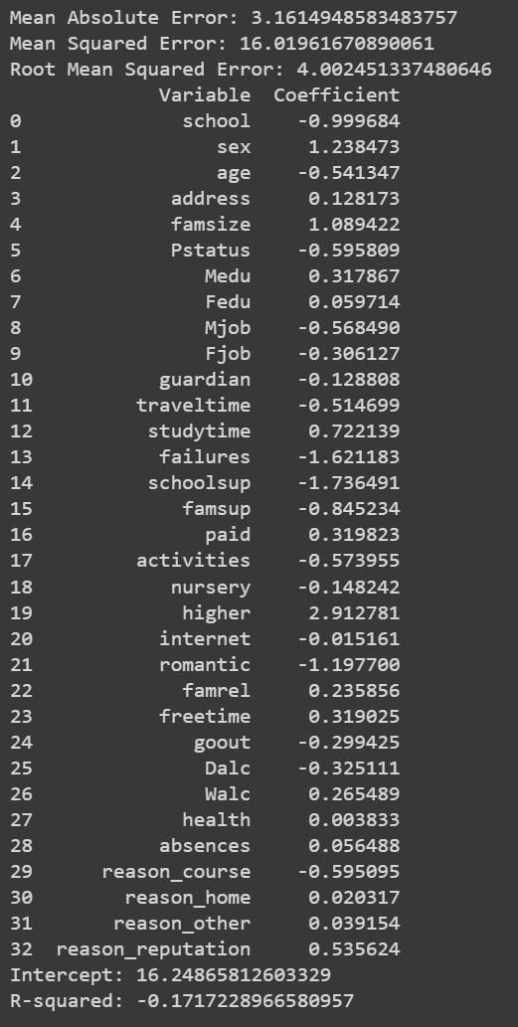
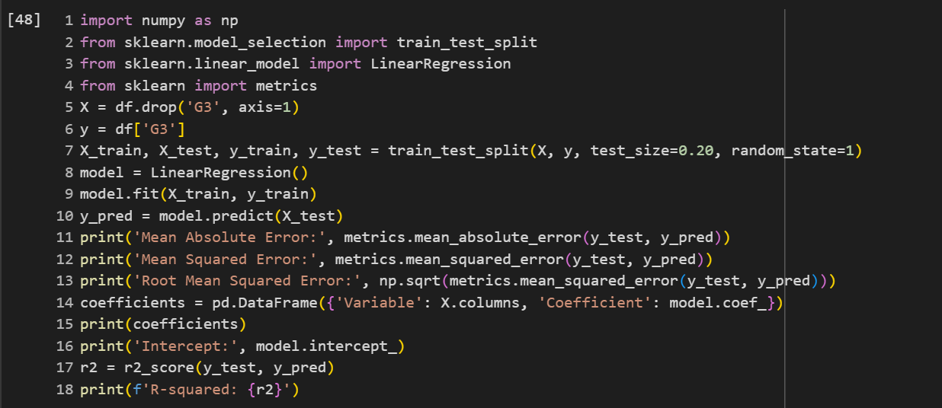
Linear Regression

Slide 24
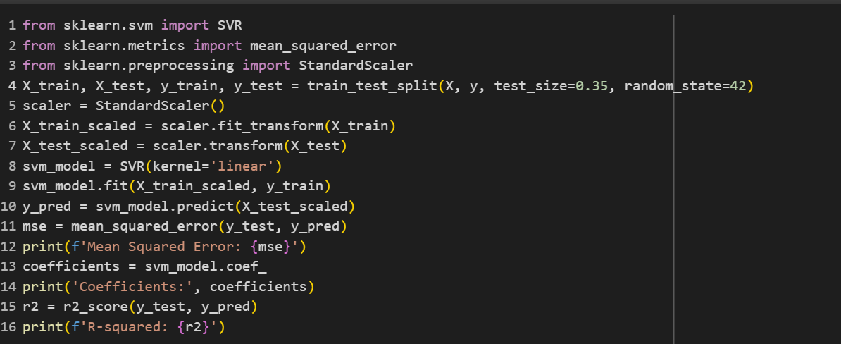
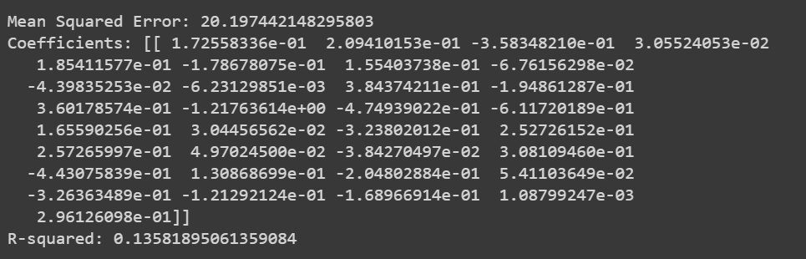
Support Vector Machine (SVM)

Slide 25
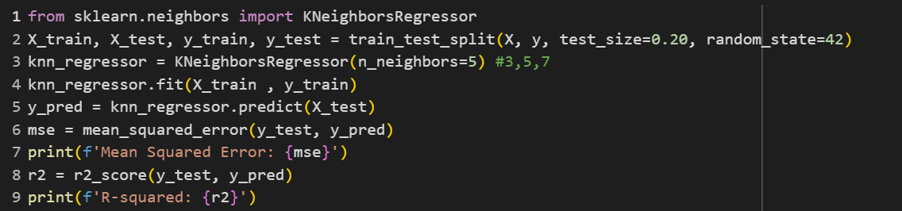

K-Nearest Neighbors (KNN)

Slide 26
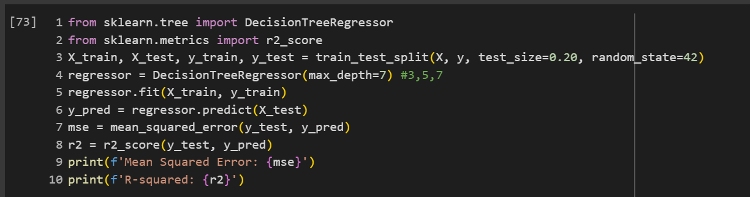

Decision Tree

Slide 27
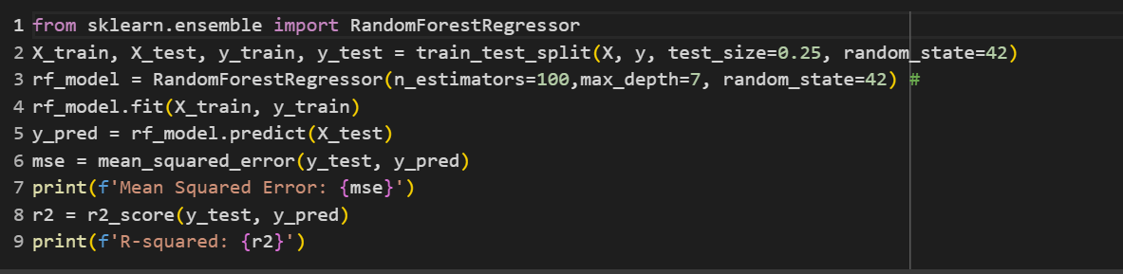

Random Forest

Slide 28
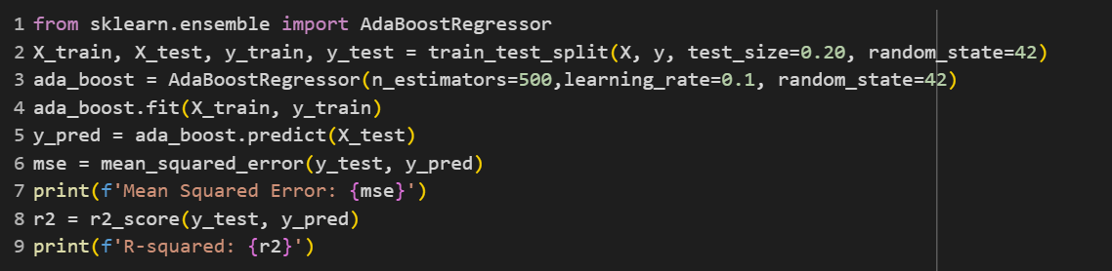

Ada Boost

Slide 29
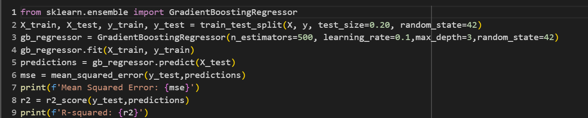

Gradient Boost

Slide 30
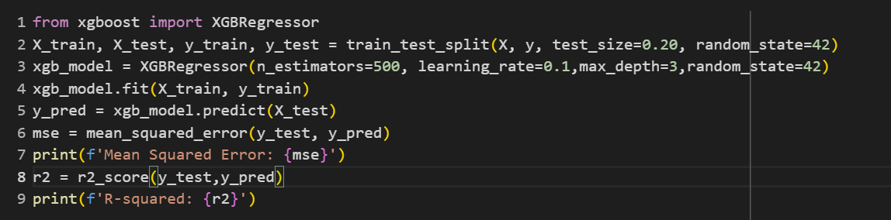

XG Boost

Slide 31
Thank you
P.Lohit Satya Sai Venkat Reddy

